Slide 1
ILP Integration Tool
How many of you know what it is?
How many of you use it?
I suggest you use it to make submitting grades much easier!
Magan Hamilton made a great presentation on how to set it up. Links to it can be found in this course in Lesson 4 page 26

Slide 2
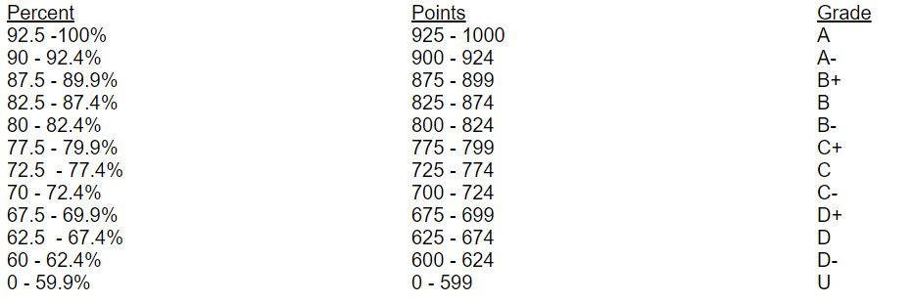
But you have to be very careful of a pitfall in it!
My syllabus grade scale looks like this:
It looks like the most you can earn is 1000 points … right? But in Blackboard, doesn’t know everything about how you run your class.

Slide 3
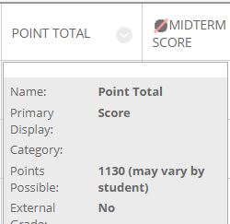
You may have extra credit projects
You may give extra credit within a test or assignment
In my case, I have several discussion topics open and students can decide which ones on the list they wish to do and ignore others.
In any case, when it comes to making out grades, you may find BB thinks you have many more points than 1000. For example, in my astronomy class, BB thinks:
Hey, BB thinks my course has 1130 points

Slide 4
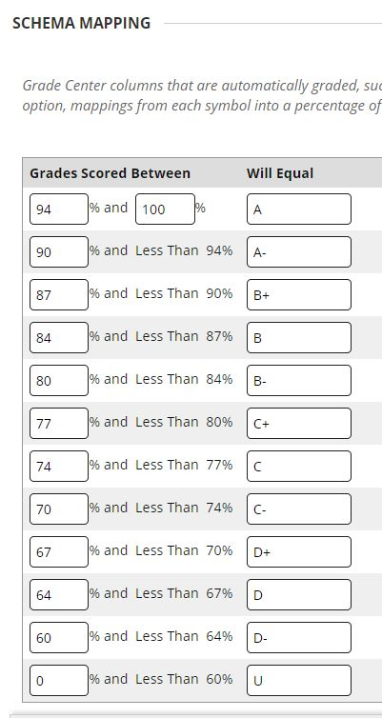
So when you construct your grading schema, you need to be very careful. This is the default grading scale:
You can NOT simply use the scale you have in your syllabus or the grades will be miscalculated!
So what do you do if your syllabus scale does not max at the same point total as seen in BB? Simple, fool BB by adjusting the grade scale.
I wrote a little Excel fix so you will get it right. All we have to do is determine how I can get that file to you if you want it.
You can get it at: http://ecampus.matc.edu/mihalj/ZERD198/BB grade fix.xls

Slide 5
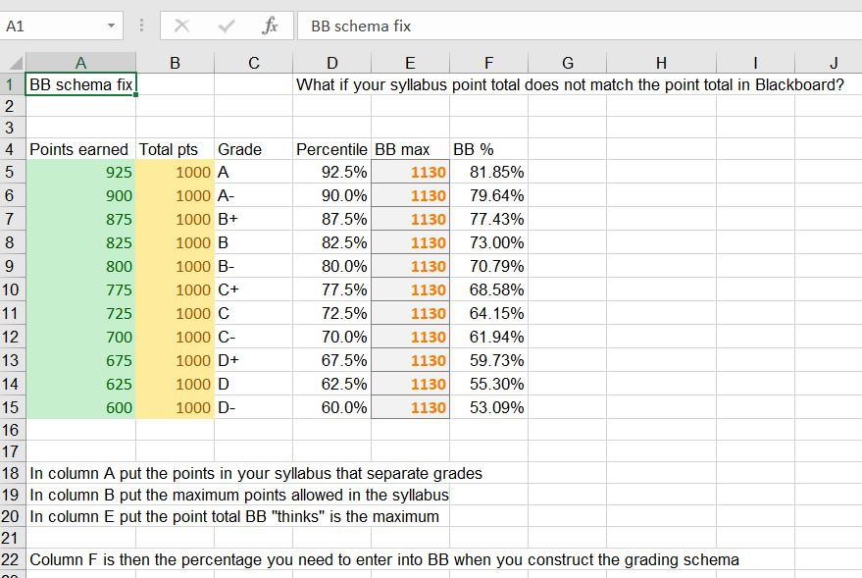
Thanks
“old guy”
Jim

Slide 6
Hey Charlie … thanks for setting this up … your turn

